Slide 1
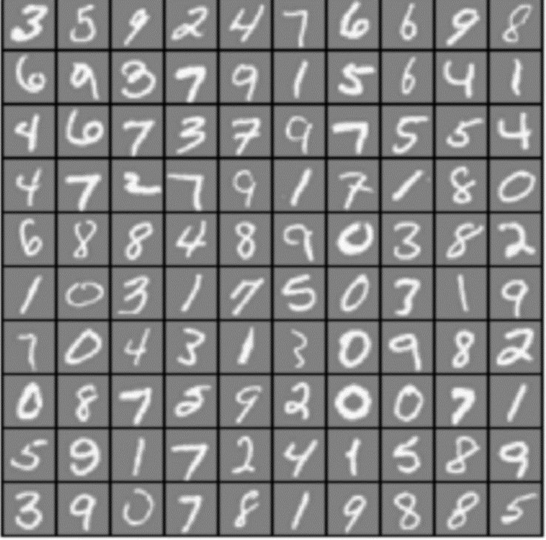
Neural Network For Handwriting Recognition
Chen Yuxuan 1W15BG12

Slide 2
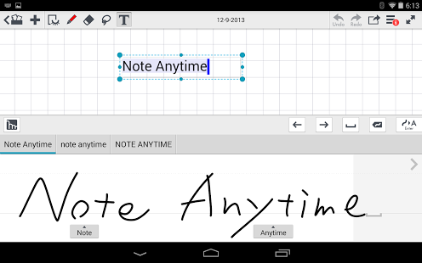
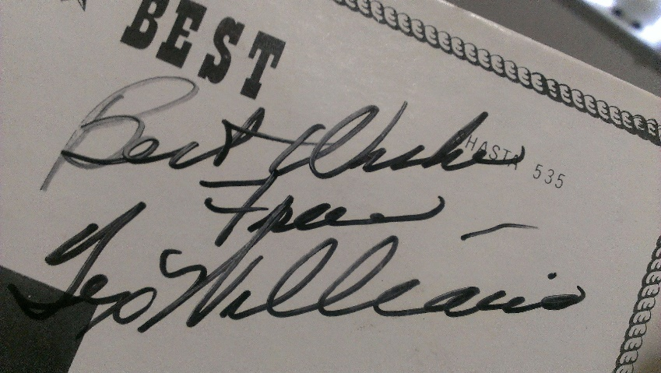
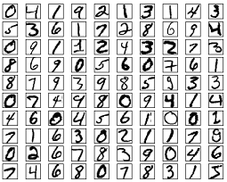
Neural Network as a POWERFUL solution for handwriting recognition
Signature of country star, Tex Williams
Numbers of Recognition
OCR software
Artificial Neural Network

Slide 3
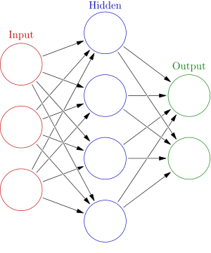
Neural Networks as the Brain
Basic Concepts
Configuration
Cost Function
Each circular node represents an artificial neuron and an arrow represents a connection from the output of one neuron to the input of another (activation function)

Slide 4
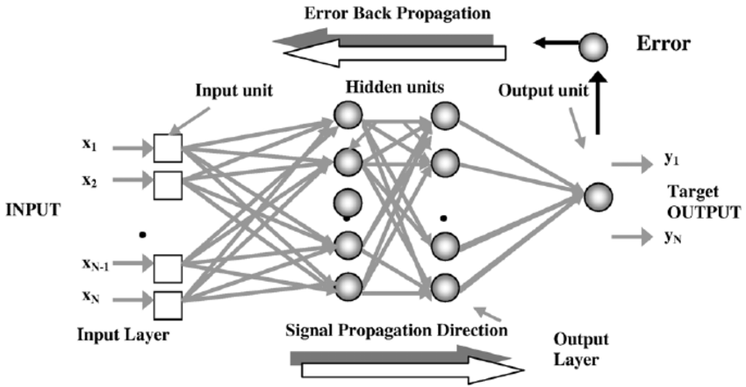
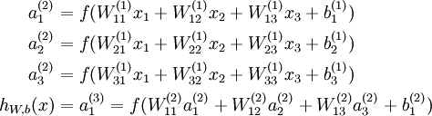
Neural Networks and Common Algorithm
1. Backpropagation, is a common method of training artificial neural networks
2. Optimization method such as gradient descent

Slide 5
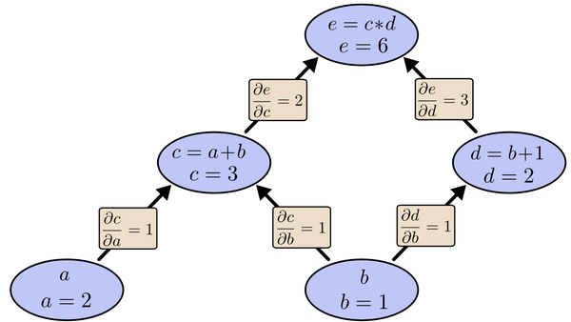

Backpropagation with Gradient descent is very efficient!

Slide 6
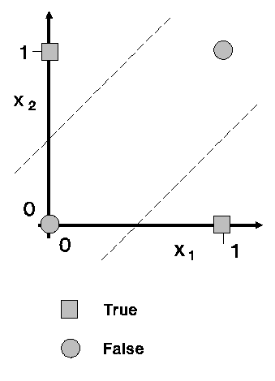
A Neural Network can be trained to solve an XOR problem
A neural network that can learn to produce the correct output given the XOR problem.
Given this input |  | Produce this output
x₁ | x₂ | y
0 | 0 | 0
0 | 1 | 1
1 | 0 | 1
1 | 1 | 0

Slide 7
Successfully Trained XOR problem
Iterations | Result of 0,0 | Deviation J
1000 | 0.47689 | 0.69423
68000 | 0.026558 | 0.037856
100000 | 0.019090 | 0.025859
Network guesses small numbers (close to 0) for the first and last XOR examples and high (close to 1)
Result is more accurate when Iterations is larger.
Successfully trained!
Given this input |  | Produce this output
x₁ | x₂ | y
0 | 0 | 0
0 | 1 | 1
1 | 0 | 1
1 | 1 | 0

Slide 8

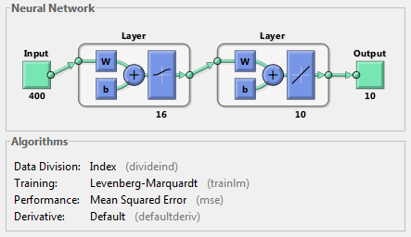
A Neural Network aimed to solve handwriting digits recognition
AIM: Build a neural network that can successfully learn to produce the correct output given the MNIST handwritten digits.

Slide 9
Trained Handwritten Digits Recognition
Accuracy | Samples | Hidden Neruons
23.3% | 120 | 4
66.7% | 120 | 16
95.5% | 5000 | 25
Training set accuracy is around 63% with the small sample (120) and small hidden neurons (16).
While, larger sample (5000), and more hidden neurons (25) yields 95%.
Sucessfully Trained!

Slide 10
So Far:
Future:
Basic Concepts of Neural Network
A Neural Network For XOR problem
A Neural Network For Handwrites Recognition
More Difficult Recognition
Possibilities of solving any problems.
Neural Network that can exceed human beings.

